Slide 1


Three B’s Surf Shop is expanding to South Africa
International Bussiness Final Project.
By Brandon Sperry

Slide 2

Three B’s Surf Shop History
Was started in a Coco Beach Florida in 1992.
First store outside of Florida was in on the North Shore of Hawaii.
The company grew quickly from there and now has over 13 stores in the USA.
It is now one of the largest surfboard building companies in the USA.
The company has a need to expand internationally now. They have their eyes set on South Africa.
South Africa is a big surf country.

Slide 3
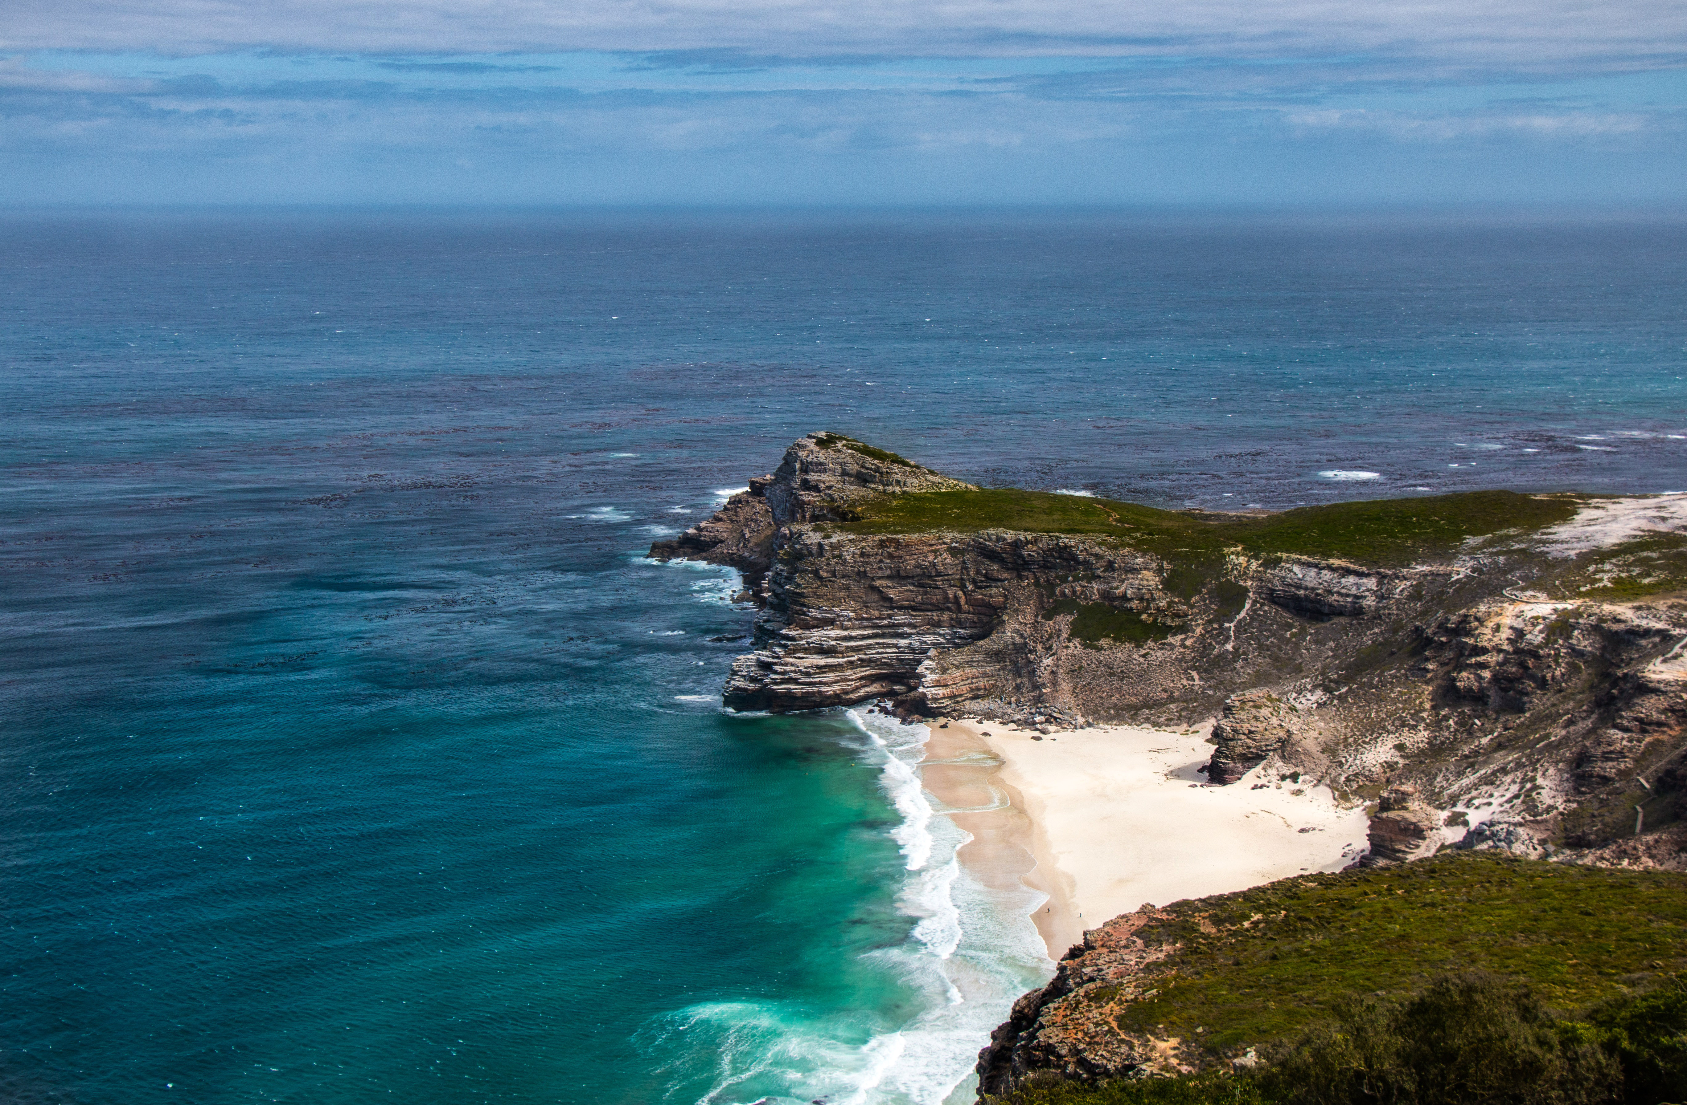
Expanding to South Africa.
South Africa has all year around surfing
Has several towns to surf in.
Has a large cost line.
Surfing is one of the most common sports in South Africa.
Some of the biggest waves can be found in Cape Town.
South Africa has a large market for surfboard building companies.

Slide 4
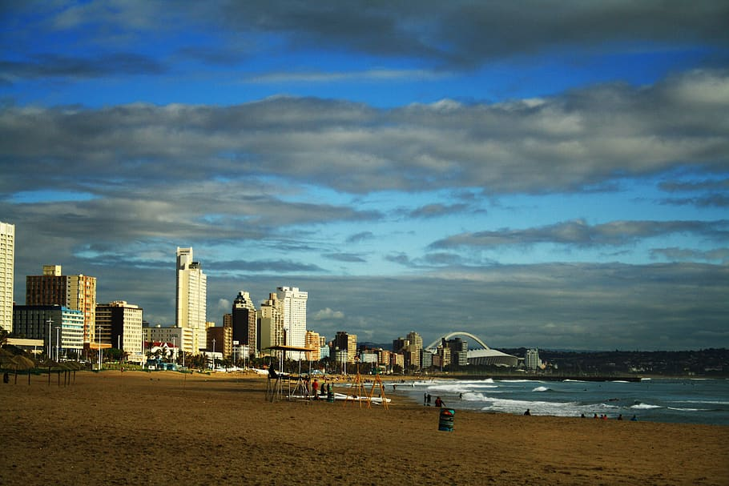
Expanding to South Africa.
Political Risk for expanding to South Africa.
One of the biggest risk would be the pandemic still has a strong hold on the country.
There is civil unrest in the country due to the pandemic.
The company has no political affiliation with any one party.
One of the biggest risk would be the crime in the country.

Slide 5

Expanding to South Africa.
Trade Environment in South Africa.
South Africa is the most advanced country in Africa for business to grow in the African market.
The most imports are fuels, automobiles, automobile parts, and broadcasting equipment.
The most exports out of South Africa are platinum, gold, diamonds, iron ore, and coal.
The main trading partners for South Africa are USA, China, Germany, UK, and India.
This Photo by Unknown Author is licensed under CC BY

Slide 6

Expanding to South Africa.
Business Etiquette
It is very important to arrive on time in South Africa. This will show your customers that you are punctual and that will make your company look good in the eyes of the consumer.
When it comes to greeting it is expected that you greet everyone that comes into your store.
To build trust with South Africans it is important that build a healthy business relationship with them. They are just like Americans where they don’t trust you unless they know you.

Slide 7
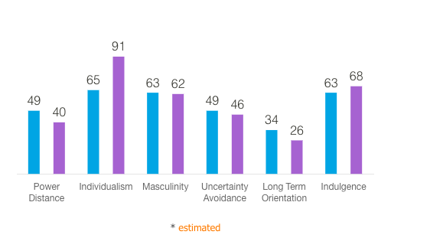
Expanding to South Africa.
Culture Values
Power Distance means that the people a hierarchical order.
Individualism means that South Africans like a loosely knit social frame work.
Masculinity with the high score South Africa is a masculine society

Slide 8
Expanding to South Africa.
Culture Values continued
Uncertainty Avoidance the score for this mean that South Africans have a relax attitude and mean that practice is more important than principles.
Long Term Orientation this mean that South Africa is more normative than pragmatic.
Indulgence the score for this means that South Africans have a willingness to realize their impules and desires with regard to enjoying life and having fun.

Slide 9
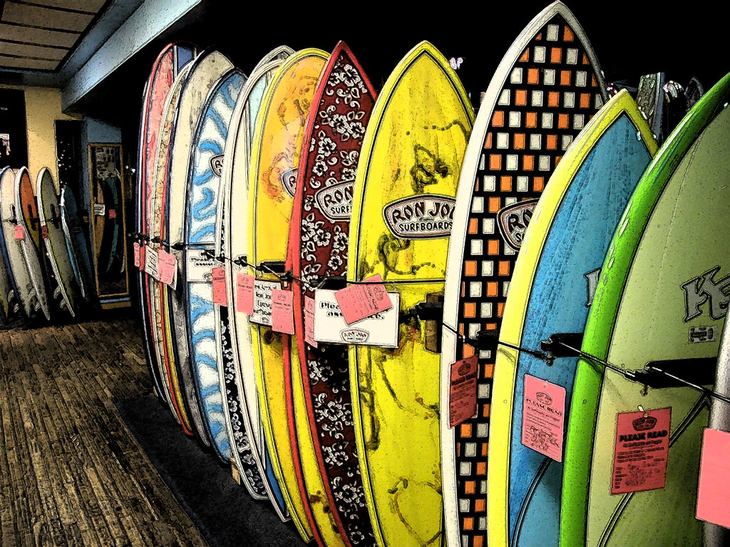
Expanding to South Africa.
Communication
The common business language in South Africa is English with South African dialect.
The communication could be different depending on what race you are speak to. The white South Africans like plain speaking where the black South African stress diplomacy so that they don’t disappoint the listener.
South African scored 49 on power distance mean that the workers in the country accepts that managers are highly above them.
This Photo by Unknown Author is licensed under CC BY-NC

Slide 10
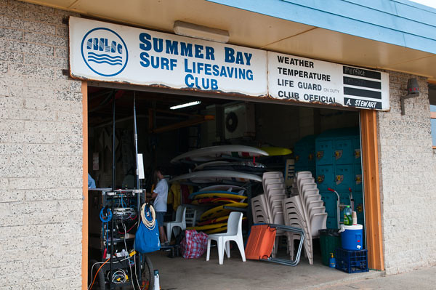
Expanding to South Africa.
Labor Relations
Commercial disputes are resolved with mediation and arbitration. This is a cheaper and faster way to resolve disputes for new business.
US companies that want to expand into the South African market must contend with a mature and competitive market.
The government has tighten labor and foreign ownership laws and mandated industrial localization.
Skilled labor can be hard to find in the country due to poor education.
This Photo by Unknown Author is licensed under CC BY-SA

Slide 11
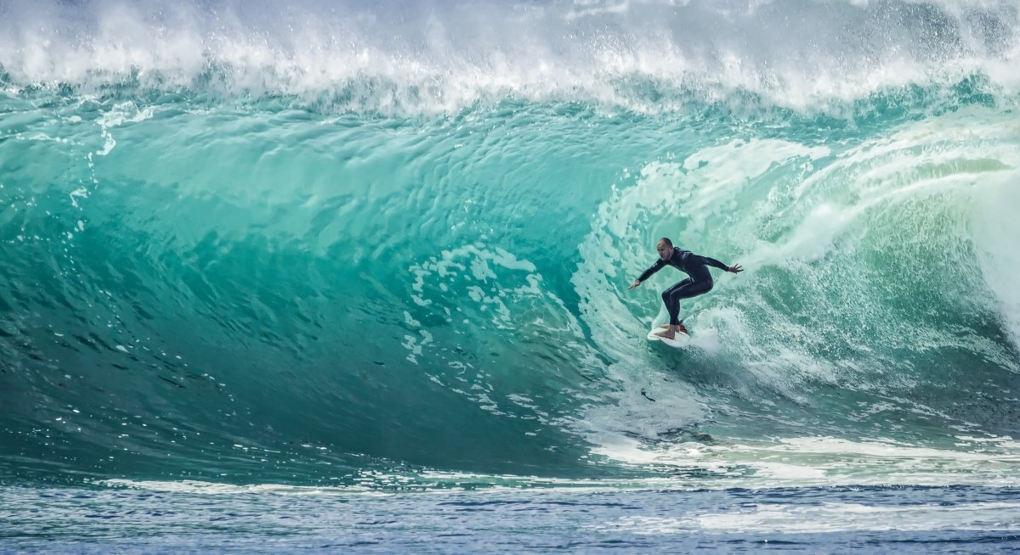
Expanding to South Africa.
FDI Entry-Related Questions
We plan to user international acquisition because this will help with keeping the company fully integrated and compliant with South African laws.
Durban is where we plan to open our store it is the surfing capital of South Africa.
One of the only challenges that we will face in trying to find the skilled works to assist with helping us build our brand in the country.
We plan to resolve this challenge by building a good rapport with the local surfers so that they will help us in find the right staff.
Building our brand in South Africa is the first step for us to move into other countries. If we are able to build our brand quickly here than that will let us know that we can expand to other countries like Sydney, Portugal, and Fiji to name just a few.

Slide 12
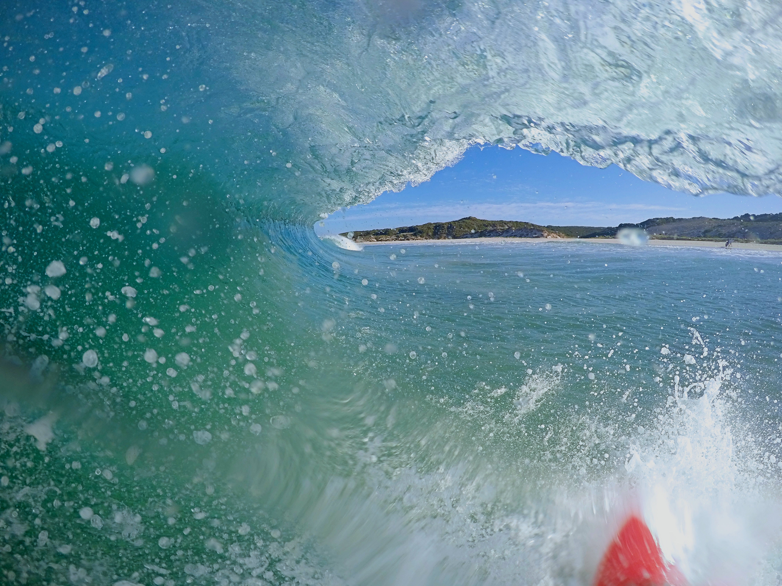
Expanding to South Africa.
References
01/07/2021. (n.d.). Home. Marsh. Retrieved April 28, 2023, from https://www.marsh.com/bw/services/political-risk/insights/political-risk-map-2021-south-africa.html
1. (n.d.). South Africa - market challenges. International Trade Administration | Trade.gov. Retrieved April 29, 2023, from https://www.trade.gov/country-commercial-guides/south-africa-market-challenges
1. (n.d.). South Africa - market overview. International Trade Administration | Trade.gov. Retrieved April 28, 2023, from https://www.trade.gov/knowledge-product/exporting-south-africa-market-overview
123helpme.com. (2021, April 30). Importance of power distance in South Africa. 1014 Words | 123 Help Me. Retrieved April 29, 2023, from https://www.123helpme.com/essay/Importance-Of-Power-Distance-In-South-Africa-473384
Commercial disputes – advice for small businesses. Du Toit's Attorneys. (2016, June 20). Retrieved April 29, 2023, from https://www.dutoitsattorney.co.za/blog/commercial-disputes-%E2%80%93-advice-small-businesses#:~:text=Dealing%20with%20a%20commercial%20dispute.&text=In%20South%20Africa%20a%20method,for%20start%2Dups%20and%20entrepreneurs.

Slide 13

Expanding to South Africa.
References
Country comparison. Hofstede Insights. (2023, January 27). Retrieved April 29, 2023, from https://www.hofstede-insights.com/country-comparison/south-africa,the-usa/
Essential guide to surfing in South Africa - Magicseaweed. Magicseaweed.com. (n.d.). Retrieved April 28, 2023, from https://magicseaweed.com/news/essential-guide-to-surfing-in-south-africa/12864/
The inside guide to durban, South Africa's surfing capital. National Geographic. (2023, January 3). Retrieved April 29, 2023, from https://www.nationalgeographic.co.uk/travel/2023/01/the-inside-guide-to-durban-south-africas-surfing-capital#:~:text=Beyond%20its%20sand%20and%20surf,lagoons%20and%20intriguing%20historical%20sites.
ltd, M. D. F. (n.d.). Surfboard market size, share & forecast: 2022 to 2027. Market Data Forecast. Retrieved April 28, 2023, from https://www.marketdataforecast.com/market-reports/surfboard-market

Slide 14

Expanding to South Africa.
References
Overseas business risk - south africa. GOV.UK. (n.d.). Retrieved April 28, 2023, from https://www.gov.uk/government/publications/overseas-business-risk-south-africa/overseas-business-risk-south-africa
Phung, A. (2022, July 13). Green Field vs. International Acquisition: What's the difference? Investopedia. Retrieved April 29, 2023, from https://www.investopedia.com/ask/answers/06/greenfieldvsacquistion.asp
Pier. (n.d.). South African culture - business culture. Cultural Atlas. Retrieved April 29, 2023, from https://culturalatlas.sbs.com.au/south-african-culture/south-african-culture-business-culture
South Africa (ZAF) exports, imports, and trade partners. OEC. (n.d.). Retrieved April 28, 2023, from https://oec.world/en/profile/country/zaf
South African Communication Styles. World Business Culture. (2021, January 24). Retrieved April 29, 2023, from https://www.worldbusinessculture.com/country-profiles/south-africa/business-communication-style/

